Slide 1
Real World Datasets Group Activity
Aashish Sood
Akashdeep Singh
Abhishek Megotia
Lakshmi Priyanka Chirumamilla
Parul Priya
(Koustav Mukherjee)

Slide 2
3 Real World Datasets
e-commerce Shopping Data
Data collected from e-commerce website like Amazon, eBay and so on
Census Data
Detailed survey of a population
Youtube Data
Livestream and online videos

Slide 3
e-commerce Shopping Data
Value – Recommendations to Users
Veracity – Legitimate Data collected from actual vendors
Variety – Images / Reviews (Data Types)
Volume - 26.5M transactions per day
Velocity - 306 transactions per second
How is the data collected
User transaction and search history
Browser Cookies
Spatial and Temporal coverage
Data is collected from millions of users across the globe, from different e-commerce websites.
Per Business Insider – “Amazon averaged 306 transactions per second at their peak in 2012. That's 26.5M transactions per day.”^{[1]}
How is the data structured
Based on categories, geographical regions etc.
Data Set is indeed a Big Data

Slide 4
Census Data
How is the data collected
Using survey and statistical models (online / offline)
Spatial and Temporal coverage
Data is collected by different countries individually
It is collected at intervals of every 5 or 10 years
How is the data structured
Demographically
Age / Gender / Nationality
Big Data ? (Debatable)
Value – Gauge Trends
Veracity – It is valid data
Variety – Usually Surveys
Volume - 370 billion cells as of 2013, with 11 billion more added every year^{[2]}
Velocity – Every 5 / 10 years

Slide 5
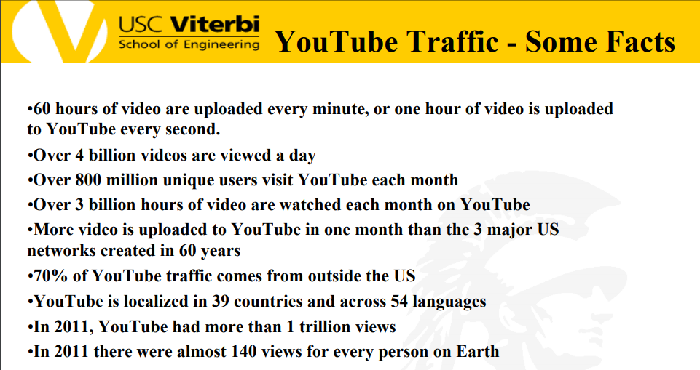
YouTube Database^{[3]}

Slide 6
Combining Data & Unintended Consequences
Shopping Data
Invading Privacy - “How Target Figured Out A Teen Girl Was Pregnant Before Her Father Did”^{[4]}
Census Data
Racial and Ethnic data can be misused (Ex: Human Trafficking)
YouTube Data
Hate / humiliating comments
Inappropriate videos could be uploaded
Shopping and Census – Targeting a population during an festival / event
Youtube and Shopping – Recommending audio CDs based on YouTube views

Slide 7
References
https://apttus.com/blog/salesforce-by-the-numbers/
https://datascience.berkeley.edu/data-innovation-day-big-data-us-census/
Professor Horowitz’s Lecture Slide
https://www.forbes.com/sites/kashmirhill/2012/02/16/how-target-figured-out-a-teen-girl-was-pregnant-before-her-father-did/#1448949f6668

